Slide 1
Understanding Data Characteristics
Based in part on notes from: Data Mining: Concepts and Techniques, Third Edition by Han, Kamber, Pei

Slide 2
Types of Data Sets
Record
Relational records
Data matrix, e.g., numerical matrix, crosstabs
Document data: text documents: term-frequency vector
Transaction data
Graph and network
World Wide Web
Social or information networks
Molecular Structures
Ordered
Video data: sequence of images
Temporal data: time-series
Sequential Data: transaction sequences
Genetic sequence data
Spatial and multimedia:
Spatial data: maps
Image data
Video data
Notes:
May we categorize data along the following dimensions?
- structured, semi-structured, and unstructured
- numeric and categorical
- static and dynamic (temporal?)
- by application

Slide 3
Data Objects
Data sets are made up of data objects.
A data object represents an entity.
Examples:
sales database: object → customers, store items, sales
medical database: object → patients, treatments
university database: object → students, professors, courses
Also called samples , examples, instances, data points, objects, tuples, vectors.
Data objects are described by attributes.
Database rows → data objects; columns → attributes.

Slide 4
Attributes
Attribute (or dimensions, features, variables): a data field representing a characteristic or property of a data object
E.g., customer _ID, name, address, income, GPA, ….
Types:
Nominal (Categorical)
Ordinal
Numeric: quantitative
Interval-scaled
Ratio-scaled

Slide 5
Attribute Types
Nominal (Categorical): categories, states, or “names of things”
Hair_color = {auburn, black, blond, brown, grey, red, white}
marital status, occupation, ID numbers, zip codes
Often attributes with “yes” and “no” as values
Binary
Nominal attribute with only 2 states (0 and 1)
Ordinal
Values have a meaningful order (ranking) but magnitude between successive values is not known.
Size = {small, medium, large}, grades, army rankings
Month = {jan, feb, mar, … }
Numeric
Quantity (integer or real-valued)
Could also be intervals or ratios

Slide 6
Basic Statistical Descriptions of Data
Before deeper analysis, it’s important to explore the basic characteristics and relationships in the data set
Descriptive Statistics
To better understand the characteristics of attributes and fields: central tendency, variation, spread, etc.
To get a feel for general patterns or relationships among variables: e.g., correlation, covariance, etc.
Data Visualization
Visual examination of data distributions often help in uncovering important patterns and guide further investigation or decision making

Slide 7
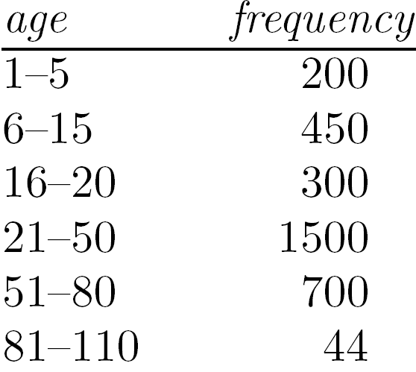
Measuring the Central Tendency
Mean (algebraic measure) (sample vs. population):
Note: n is sample size and N is population size.
Weighted arithmetic mean:
Trimmed mean: chopping extreme values
Median:
Middle value if odd number of values, or average of the middle two values otherwise
Estimated by interpolation (for grouped data):
Mode
Value that occurs most frequently in the data
Unimodal, bimodal, trimodal
Empirical formula:
Median interval

Slide 8
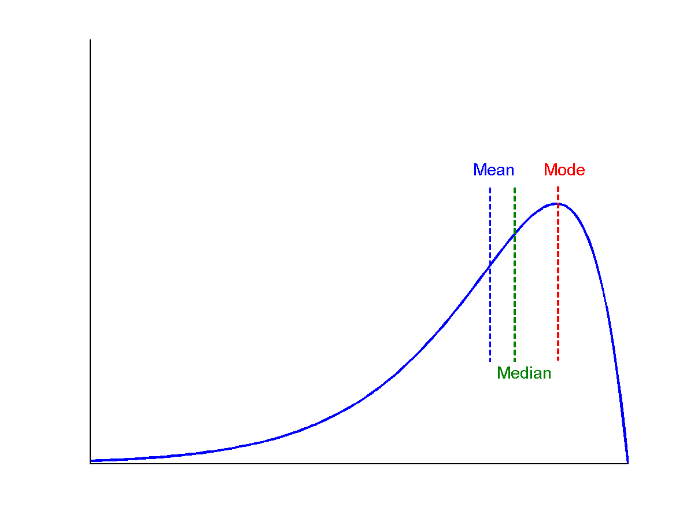
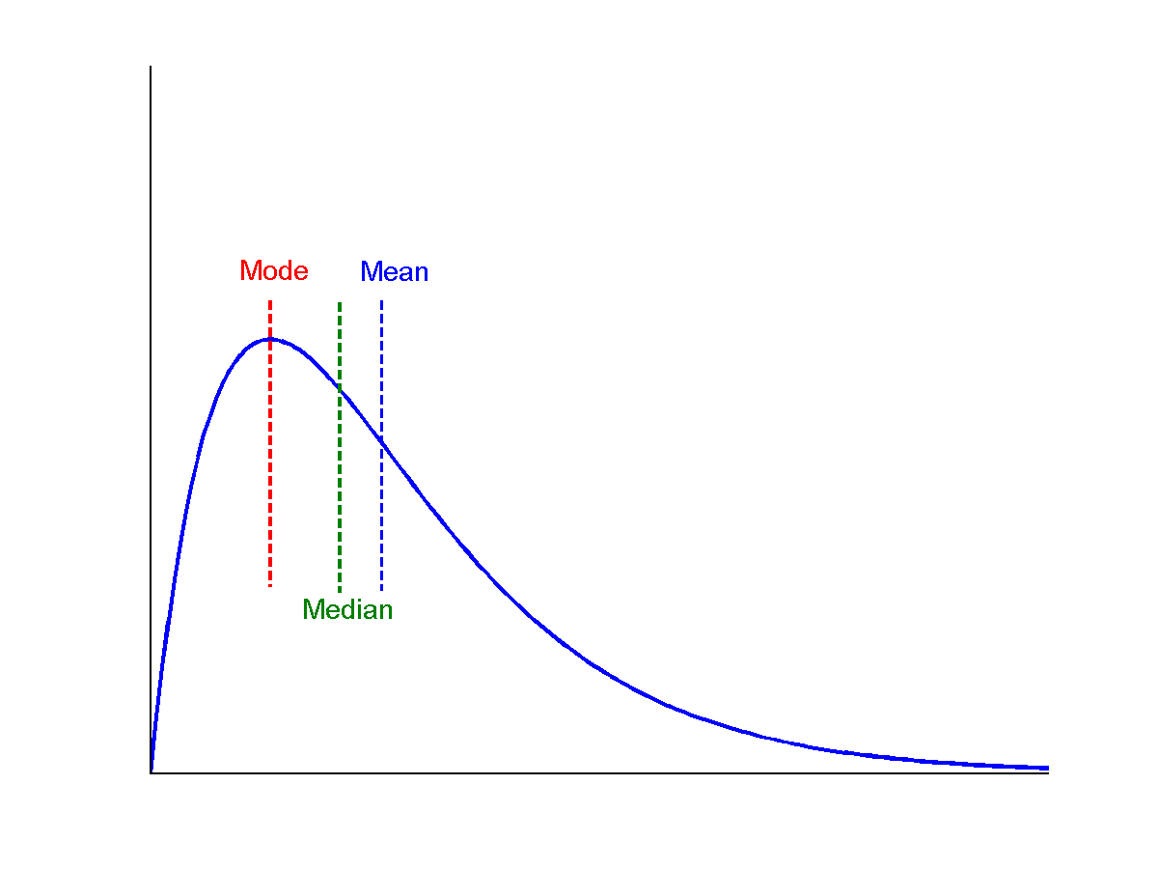
Symmetric vs. Skewed Data
Median, mean and mode of symmetric, positively and negatively skewed data
symmetric
positively skewed
negatively skewed

Slide 9
Measuring the Dispersion of Data
Quartiles, outliers and boxplots
Quartiles: Q₁ (25th percentile), Q₃ (75th percentile)
Inter-quartile range: IQR = Q₃ – Q₁
Five number summary: min, Q₁, median, Q₃, max
Boxplot: ends of the box are the quartiles; median is marked; add whiskers, and plot outliers individually
Outlier: usually, a value higher/lower than 1.5 x IQR
Variance and standard deviation (sample: s, population: σ)
Variance: (algebraic, scalable computation)
Standard deviation s (or σ) is the square root of variance s² ⁽or σ²⁾

Slide 10
Properties of Normal Distribution Curve
The normal (distribution) curve
From μ–σ to μ+σ: contains about 68% of the measurements (μ: mean, σ: standard deviation)
From μ–2σ to μ+2σ: contains about 95% of it
From μ–3σ to μ+3σ: contains about 99.7% of it

Slide 11
Graphic Displays of Basic Statistical Descriptions
Boxplot: graphic display of five-number summary
Histogram: x-axis are values, y-axis repres. frequencies
Quantile plot: each value x_{i} is paired with f_{i} indicating that approximately 100 f_{i} % of data are ≤ x_{i}
Quantile-quantile (q-q) plot: graphs the quantiles of one univariant distribution against the corresponding quantiles of another
Scatter plot: each pair of values is a pair of coordinates and plotted as points in the plane
Notes:
JH: Maybe we can remove Loess curve

Slide 12
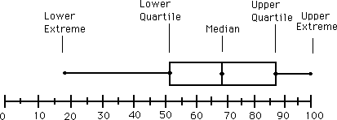
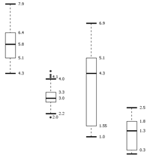
Boxplot Analysis
Five-number summary of a distribution
Minimum, Q1, Median, Q3, Maximum
Boxplot
Data is represented with a box
The ends of the box are at the first and third quartiles, i.e., the height of the box is IQR
The median is marked by a line within the box
Whiskers: two lines outside the box extended to Minimum and Maximum
Outliers: points beyond a specified outlier threshold, plotted individually

Slide 13
Histogram Analysis
Histogram: Graph display of tabulated frequencies, shown as bars
It shows what proportion of cases fall into each of several categories
Differs from a bar chart in that it is the area of the bar that denotes the value, not the height as in bar charts, a crucial distinction when the categories are not of uniform width
The categories are usually specified as non-overlapping intervals of some variable. The categories (bars) must be adjacent

Slide 14
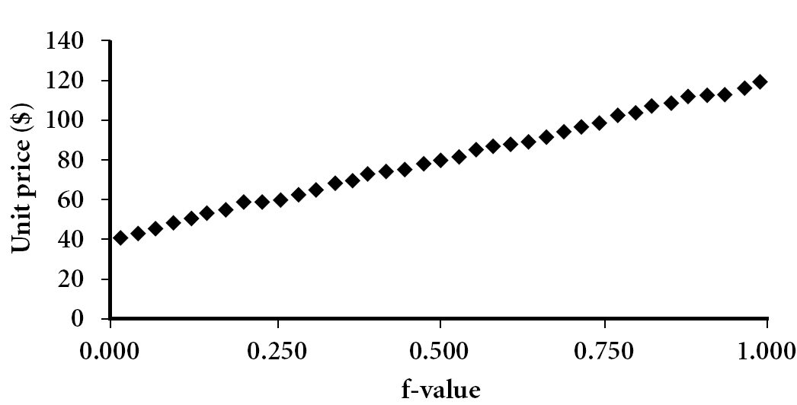
Quantile Plot
Displays all of the data (allowing the user to assess both the overall behavior and unusual occurrences)
Plots quantile information
For a data x_{i} data sorted in increasing order, f_{i} indicates that approximately 100 f_{i}% of the data are below or equal to the value x_{i}

Slide 15
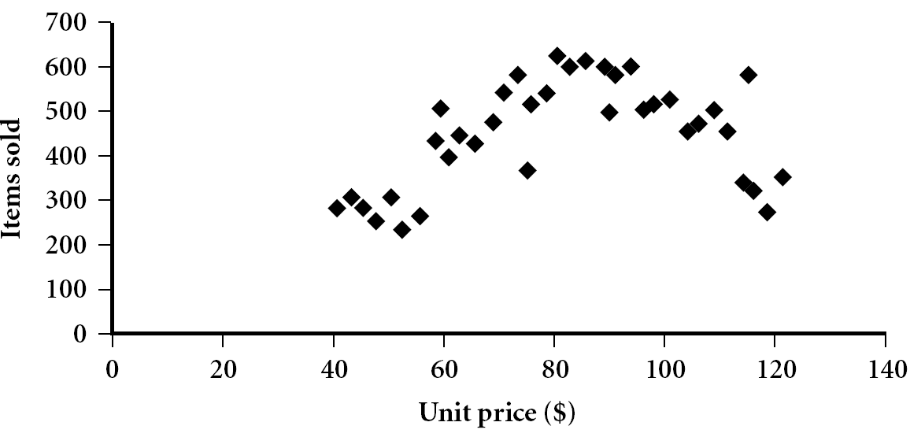
Scatter plot
Provides a first look at bivariate data to see clusters of points, outliers, etc
Each pair of values is treated as a pair of coordinates and plotted as points in the plane

Slide 16
Positively and Negatively Correlated Data
Above-left: positively correlated
Above-right: negative correlated

Slide 17
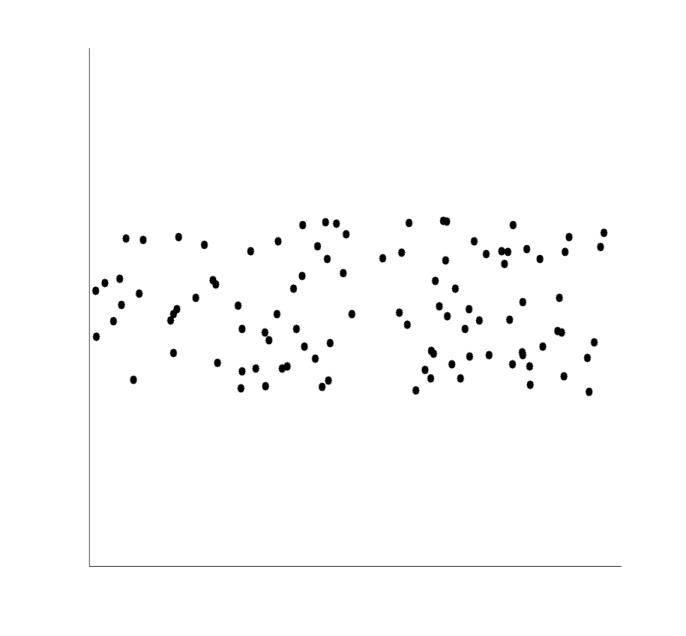
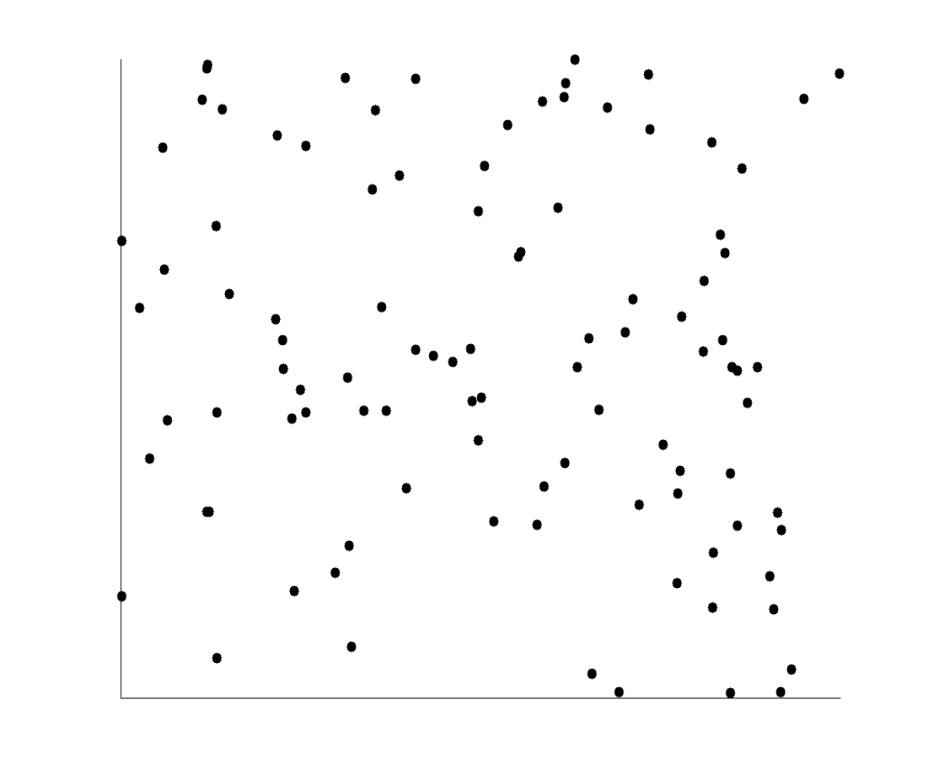
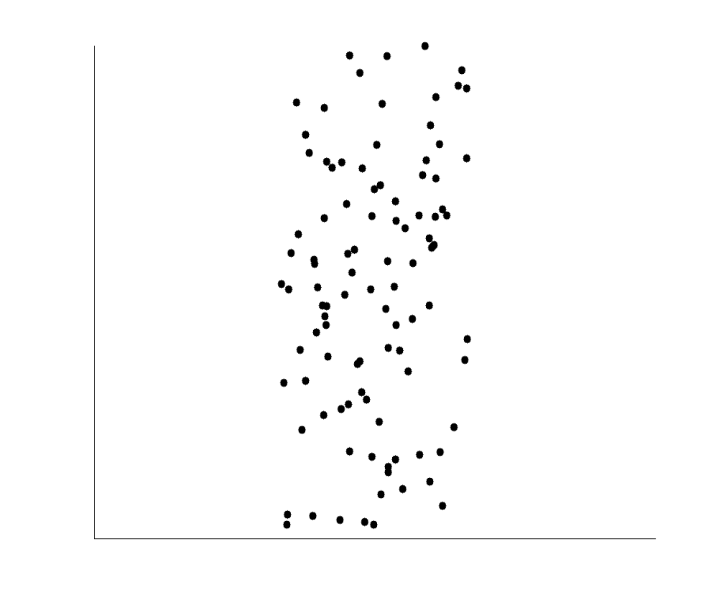
Uncorrelated Data

Slide 18
Correlation Analysis (Nominal Data)
Χ² (chi-square) test
The larger the Χ² value, the more likely the variables are related
The cells that contribute the most to the Χ² value are those whose actual count is very different from the expected count
Correlation does not imply causality
# of hospitals and # of car-theft in a city are correlated
Both are causally linked to the third variable: population

Slide 19
Chi-Square Calculation: An Example
Χ² (chi-square) calculation (numbers in parenthesis are expected counts calculated based on the data distribution in the two categories)
It shows that like_science_fiction and play_chess are correlated in the group
 | Play chess | Not play chess | Sum (row)
Like science fiction | 250(90) | 200(360) | 450
Not like science fiction | 50(210) | 1000(840) | 1050
Sum(col.) | 300 | 1200 | 1500

Slide 20
Correlation Analysis (Numeric Data)
Correlation coefficient (also called Pearson’s product moment coefficient)
where n is the number of tuples, and are the respective means of A and B, σ_{A} and σ_{B} are the respective standard deviation of A and B, and Σ(a_{i}b_{i}) is the sum of the AB cross-product.
If r_{A,B} > 0, A and B are positively correlated (A’s values increase as B’s). The higher, the stronger correlation.
r_{A,B} = 0: independent; r_{AB} < 0: negatively correlated

Slide 21
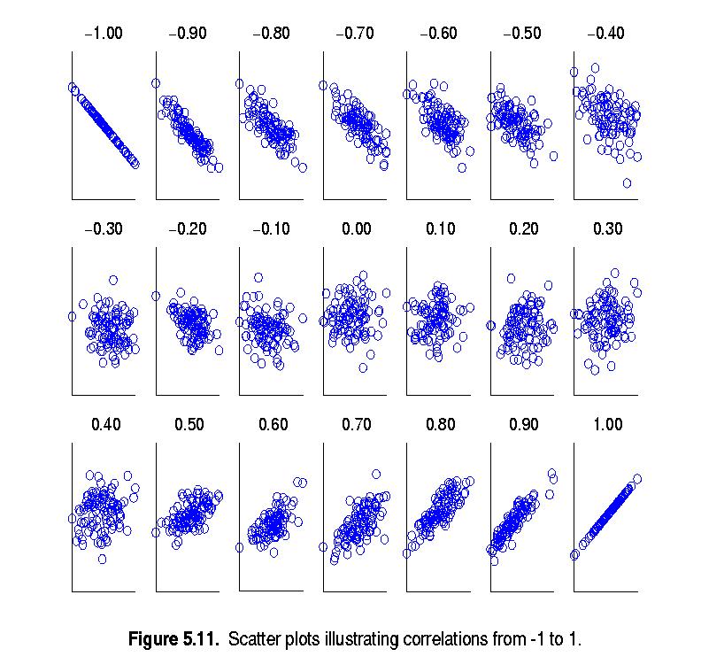
Visually Evaluating Correlation
Scatter plots showing the similarity from –1 to 1.

Slide 22
Correlation (viewed as linear relationship)
Correlation measures the linear relationship between objects
To compute correlation, we standardize data objects, A and B, and then take their dot product

Slide 23
Visualizing Patterns Using Aggregation
Example: Cross Tabulation
 | Windy | Not Windy
Outlook = sunny | 2 | 3
Outlook = rain | 2 | 3
Outlook = overcast | 2 | 2

Slide 24
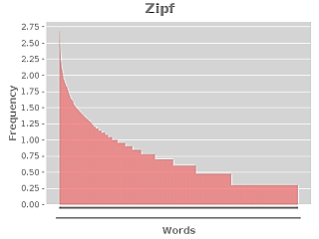

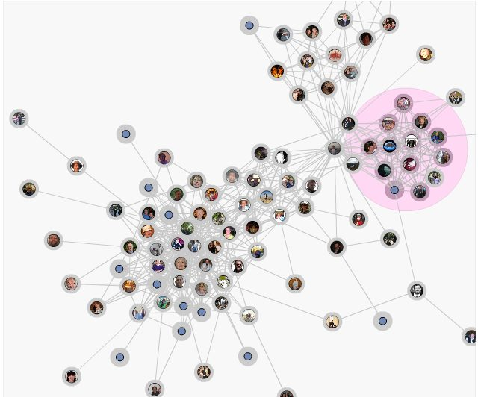
Other Types of Statistics / Visualization
Understanding Properties of Text
Zipf distribution
TF x IDF
Tag/Word Clouds
Graph Visualization

